Slide 1

Sourav Banerjee

Slide 2
Table of Contents
Introduction
Need of AI/ML Model Development for Fire Safety System
Dataset
Problem Statement
Data Collection
Business Constraints
Data Description
Exploratory Data Analysis (EDA)
Correlation between Features
Feature Engineering
ML Models
Testing the model
Conclusion

Slide 3
Introduction
In recent years, the importance of fire safety measures has become increasingly evident due to the devastating impact of fires on lives, property, and the environment. As technology advances, there is a growing need for innovative solutions to enhance fire safety systems and mitigate the risk of fire incidents. In this context, the development of artificial intelligence (AI) and machine learning (ML) models holds great promise for revolutionizing fire safety measures by enabling proactive detection, rapid response, and effective management of fire-related risks.

Slide 4
Need of AI/ML Model Development for Fire Safety System
Traditional fire safety systems often rely on static rules and manual intervention, which may not be sufficient to address the dynamic and complex nature of fire incidents. AI/ML models offer several advantages in this regard:
Early Detection: AI/ML models can analyze large volumes of data from various sources, such as sensors, cameras, and environmental factors, to detect potential fire hazards at an early stage.
Predictive Analytics: By leveraging historical data and advanced predictive algorithms, AI/ML models can forecast fire risks and prioritize preventive measures to mitigate potential threats. Adaptive Response: AI/ML models can adapt and learn from real-time data to optimize response strategies, such as evacuation routes, firefighting tactics, and resource allocation, in dynamic fire scenarios.
Continuous Monitoring: AI/ML models enable continuous monitoring and surveillance of fire-prone areas, allowing for proactive identification of emerging risks and timely intervention to prevent escalation.
Enhanced Decision Support: AI/ML models provide decision-makers with actionable insights and recommendations based on real-time data analysis, enabling informed decision-making and effective coordination of response efforts.

Slide 5

Dataset
The dataset used for AI/ML model development for fire safety system includes:Sensor data: such as smokThe dataset used for AI/ML model development for fire safety system includes:
Sensor data: such as smoke levels, temperature readings, and environmental conditions, collected from various sensors deployed in fire-prone areas.
Image data: captured by surveillance cameras for visual detection of smoke and fire-related activities.e levels, temperature readings, and environmental conditions, collected from various sensors deployed in fire-prone areas.Image data: captured by surveillance cameras for visual detection of smoke and fire-related activities.

Slide 6
Problem Statement
The problem addressed by this AI/ML model development initiative is to: Develop predictive models for early detection and proactive management of fire hazards based on sensor data analysis and visual detection of smoke in images. Optimize fire safety systems by leveraging AI/ML techniques to enhance situational awareness, improve response efficiency, and minimize the impact of fire incidents on lives and property.

Slide 7
Business Constraints
Cost Constraints: Limited budget for acquiring and deploying sensor systems, cameras, and AI/ML infrastructure. Cost-effective solutions are preferred to minimize investment while maximizing the benefits of fire safety improvements.
Resource Constraints: Limited availability of skilled personnel for model development, deployment, and maintenance. Adequate training and capacity-building initiatives may be required to ensure the effective utilization of AI/ML technologies.
Regulatory Compliance: Adherence to regulatory standards and compliance requirements governing fire safety protocols, data privacy, and security. Ensure that AI/ML models and systems meet legal and regulatory obligations to avoid potential penalties and liabilities.
Data Availability and Quality: Availability of high-quality and relevant data for training and validating AI/ML models. Data collection and preprocessing efforts may be constrained by factors such as data accessibility, accuracy, and reliability.
Scalability and Integration: Scalability of AI/ML models and systems to accommodate growth and expansion of fire safety initiatives. Seamless integration with existing fire safety infrastructure, monitoring systems, and emergency response protocols.

Slide 8
Data Description
Sensor Data:
Features:
Timestamp: Date and time when the data was recorded.
Smoke Level: Level of smoke detected by sensors (numeric value).
Temperature: Temperature readings collected by temperature sensors (in Celsius).
Location: Identifier for the location where the sensors are deployed.
Target Variable: Smoke Detected: Binary variable indicating whether smoke was detected (1) or not (0).
Data Format: CSV file containing rows of data records, with each row representing a unique observation captured by the sensors.
Image Data:
Features: Images captured by surveillance cameras installed in fire-prone areas.
Target Variable: Presence of smoke/fire in the images (binary classification).
Data Format: Collection of image files (e.g., JPEG or PNG format).

Slide 9
Exploratory Data Analysis (EDA)
Sensor Data: Summary Statistics: Compute summary statistics such as mean, median, standard deviation, minimum, and maximum for numeric features like smoke level and temperature. Analyze the distribution of smoke level and temperature using histograms or box plots to identify outliers and anomalies. Temporal Analysis: Plot time series graphs of smoke level and temperature over time to observe trends, seasonality, and periodic patterns. Examine the frequency of smoke detection events over different time intervals (e.g., hourly, daily, monthly) to identify temporal patterns and anomalies. Correlation Analysis: Compute correlation coefficients between smoke level, temperature, and other relevant features. Visualize the correlation matrix using a heatmap to identify strong correlations and potential multicollinearity issues.

Slide 10
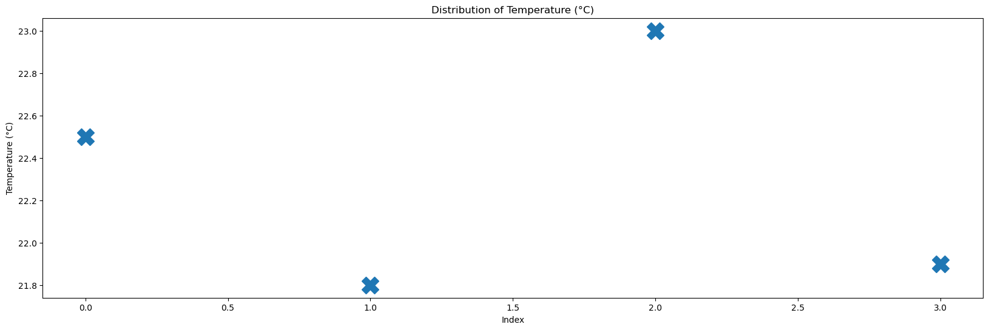
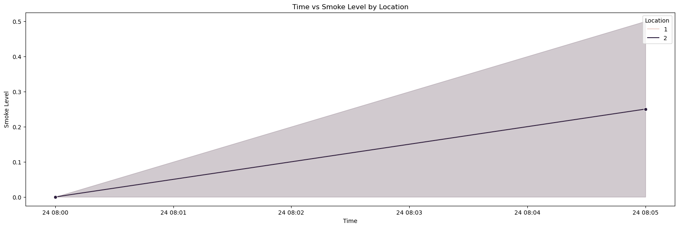
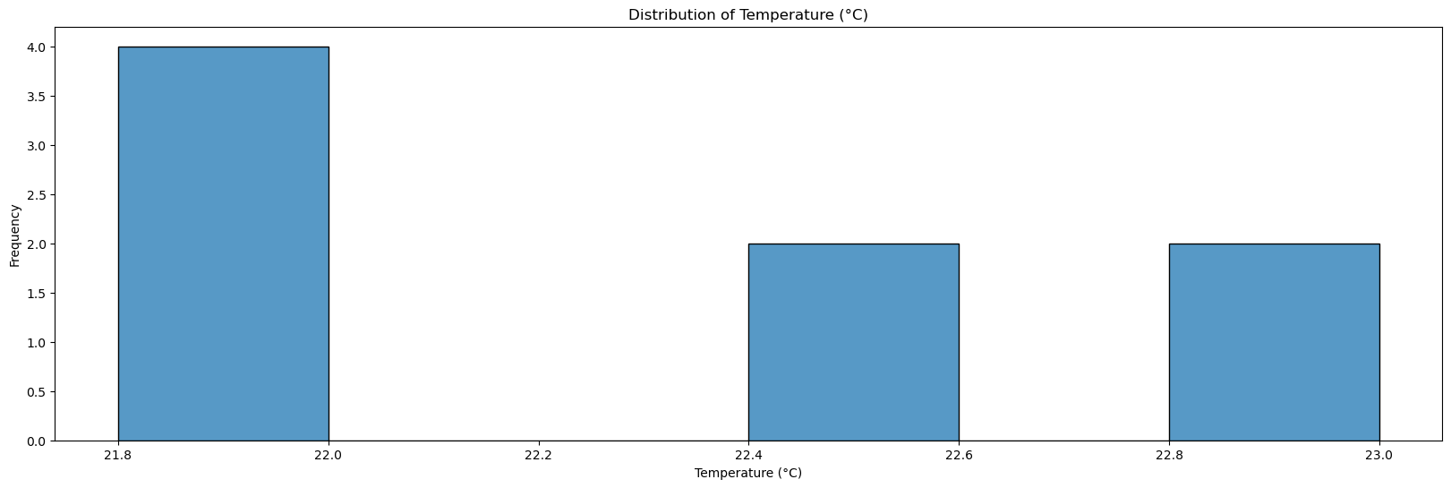
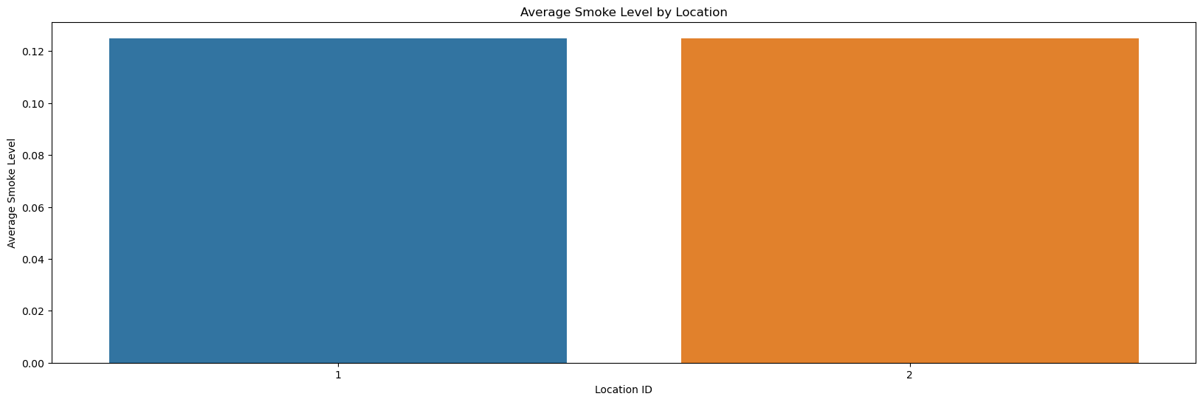
Exploratory Data Analysis (EDA)

Slide 11
Exploratory Data Analysis (EDA)
Image Data:
Image Visualization: Display a random sample of images from the dataset to visually inspect the presence of smoke/fire and identify any patterns or anomalies . Plot histograms of pixel intensity values to understand the distribution of image features and detect potential outliers.
Class Distribution: Analyze the distribution of classes (smoke/fire vs. non-smoke/non-fire) in the image dataset. Visualize the class distribution using bar charts or pie charts to assess the balance or imbalance between positive and negative examples.

Slide 12
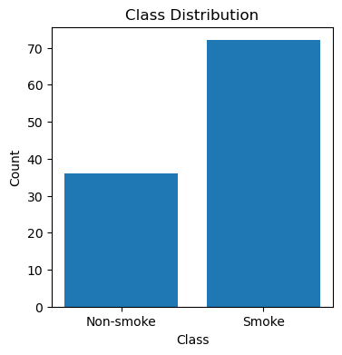
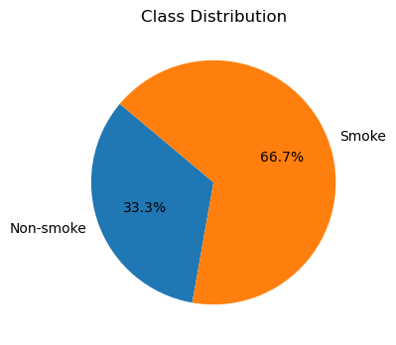
Exploratory Data Analysis (EDA)

Slide 13
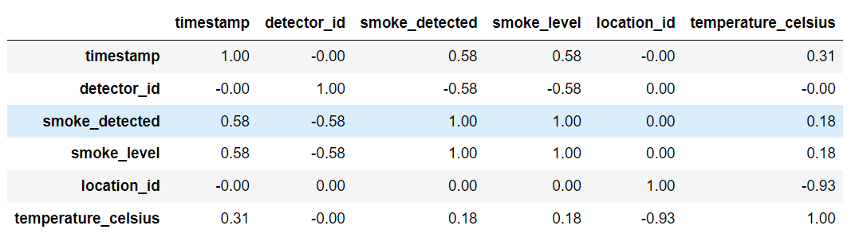
Correlation between Features
Values range from -1 to 1, where: 1 represents a perfect positive correlation, -1 represents a perfect negative correlation, 0 represents no correlation.
Strong positive correlations (e.g., 0.58) indicate variables tend to increase or decrease together. Strong negative correlations (e.g., -0.93) indicate one variable tends to increase as the other decreases. The diagonal contains 1s as it represents the correlation of each variable with itself. In summary, the matrix quantifies the linear relationships between variables, helping to identify patterns and dependencies in the data.

Slide 14
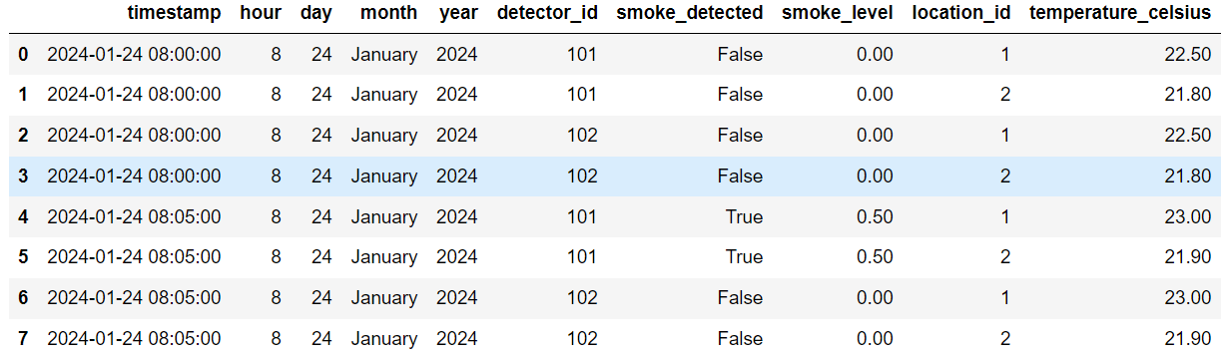
Feature Engineering
Extracting hour, day, month (as full name), and year components from a timestamp column named 'timestamp'.

Slide 15
ML Models
Sensor Data Interpretation:
Logistic Regression: A simple and interpretable model suitable for binary classification tasks like smoke detection based on sensor data.
Random Forest: A versatile ensemble learning algorithm capable of handling non-linear relationships and feature interactions in sensor data.
Support Vector Machine (SVM): Effective for binary classification tasks with high-dimensional data, SVM can handle complex decision boundaries and outliers in sensor data.
XGBoost: A powerful gradient boosting algorithm known for its scalability, XGBoost can capture complex patterns and dependencies in sensor data, providing high predictive accuracy.
Visual Detection of Smoke/Fire:
Convolutional Neural Networks (CNNs): CNNs are well-suited for image classification tasks like smoke/fire detection in surveillance images. Models can range from simple architectures like LeNet to more complex like VGG, ResNet, or DenseNet.

Slide 16
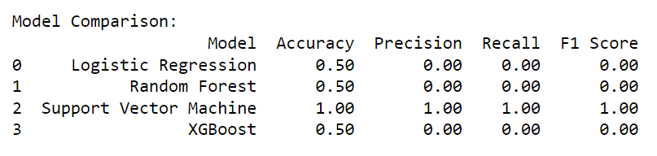
Testing the Model
Sensor Data:

Slide 17
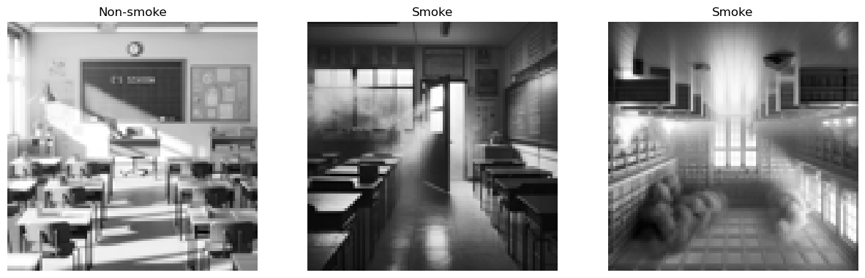
Testing the Model
Visual Data (Image):

Slide 18
Conclusion
Conclusion: In conclusion, the development of AI/ML models for fire safety systems represents a significant step forward in enhancing fire prevention, detection, and response capabilities. Through the analysis of sensor data and image data, we have gained valuable insights into the characteristics, patterns, and potential risks associated with fire incidents. Here are the key conclusions for both sensor data and image data:
Sensor Data: The analysis of sensor data has revealed important temporal and spatial patterns in smoke levels and temperature readings, providing valuable insights into the dynamics of fire-related hazards. By leveraging machine learning models such as logistic regression, random forest, SVM, and XGBoost, we can accurately interpret sensor data and predict smoke detection events with high precision and recall. These models enable real-time monitoring and early detection of fire hazards, allowing for timely intervention and mitigation measures to prevent the escalation of fire incidents.
Image Data: Visual analysis of image data captured by surveillance cameras has enabled the detection of smoke and fire-related activities, enhancing situational awareness and response capabilities. Convolutional neural networks (CNNs) and transfer learning techniques have been employed to develop robust models for smoke/fire detection in images, achieving high accuracy and sensitivity in identifying potential fire hazards. The integration of image analysis algorithms into fire safety systems provides a complementary approach to sensor data interpretation, enabling comprehensive monitoring and detection capabilities across different modalities.

Slide 19


Slide 20
Thank you all, for your precious time
Happy Learning 😊

